Slide 1
Implementation of a Telerobotic Application with Gesture Recognition from EMG Signals
https://github.com/mahasiswateladan/emg
Notes:
Are your classroom colors different than what you see in this template? That’s OK! Click on Design -> Variants (the down arrow) -> Pick the color scheme that works for you!
Feel free to change any “You will…” and “I will…” statements to ensure they align with your classroom procedures and rules!

Slide 2
Project description
This project aims to implement telerobotics using a Myo armband as a controller by reading EMG signals of human muscle activation to control a robotic arm.
Myo armband will use as an input device (controller), Myo armband is a wearable technology with eight electromyographic (EMG) electrodes, a gyroscope, an accelerometer, and a magnetometer.
The robot used are uArm Swift Pro robot, the robot is basically of 4 Degree-of-Freedom having 4 links out of which one is fixed one and 4 joints out of which 3 are rotational pair and 1 is prismatic pair.
The EMG signals would be classified using state-of-the-art Deep Learning in multi-channel time-series processing.

Slide 3
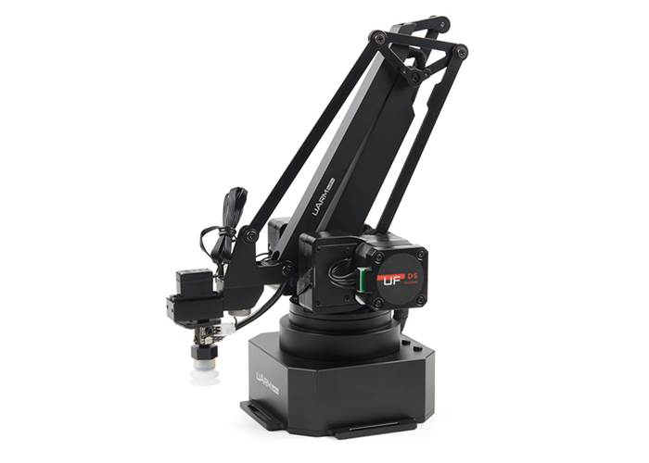
Robot Controller
The robot used is UFACTORY uArm SwiftPro
uArm-Python-SDK is used to control the robot in python (https://github.com/uArm-Developer/uArm-Python-SDK)
The robot has Articulated Robots mechanical movement and configuration that closely resembles a human arm
The robot has its workspace to move, and we have to give commands that contain the head protocol, coordinate (x, y, z), and speed to move the robot.

Slide 4
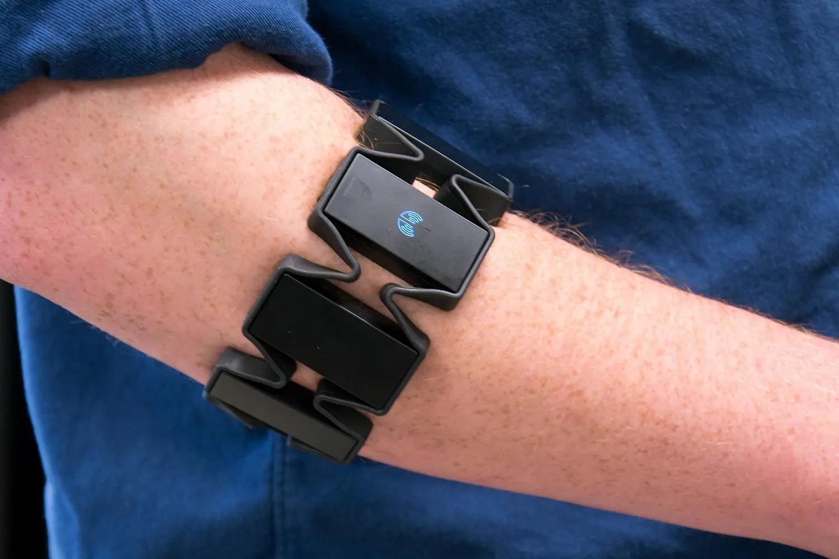
Myo armband
The device is provided with 8 EMG electrodes along with 3-axes accelerometer, 3-axes gyroscope and 3-axes magnetometer.
It transmits data via Bluetooth at 200Hz frequency
myo-sdk-win-0.9.0 is used to read the armband using python (https://github.com/NiklasRosenstein/myo-python/releases)
To used the armband we have to pairing it with the laptop and calibrate it using the apps (Myo+Connect+Installer.exe ), after that we can use it and read the data with python.

Slide 5
Paper Review: Electromyography Signal-based Gesture Recognition for Human-Machine Interaction in Real-Time through Model Calibration
The main idea of this paper is to show that model calibration worked better than current state-of-the-art methods when processing a real-time electromyographical signal in a post-learning environment
The dataset consists of 300 samples from 15 participants (9 men and 6 women). Participants use armbands on their right forearm, then be instructed to perform gestures a closed fist (finger flexion), spread open fingers (finger abduction), waving inwards (wrist flexion), and waving outwards (wrist extension) repeatedly for 60 seconds. To access the dataset you can used this link https://www.kaggle.com/datasets/chrisdolopikos/eleectromyography-dataset
For data preprocessing there are several step:
Data Cleaning
Rectification
Feature Extraction (used sliding 1-second windows with 0.5 overlap and with combination of Time-domain features &Frequency-domain features as extractor)

Slide 6
Paper Review: Electromyography Signal-based Gesture Recognition for Human-Machine Interaction in Real-Time through Model Calibration
There are several model that the author used in the research:
Support Vector Machine
Random Forest
Artificial Neural Network (optimized parameters used for the Multilayer Perceptron was hence an L-BFGS solver, 20 neurons, 0.1 learning rate.)
Deep Neural Network (The DNN used for the on-the-y real-time emulation consists of five hidden layers with the ReLU activation function)
The three classical classifiers are combined into a single model through an ensemble voting system which scores 91.93% compared to the Deep Neural Network which achieves a performance of 88.68%, both after calibrating to a subject and performing real-time classification (pre-calibration scores for the two being 67.87% and 74.27% respectively).

Slide 7
EMG Classification
The main task is to build a machine-learning model that can classify hand gestures in real-time. The model was created based on the LSTM, CNN-LSTM model and expanded to use Time2Vec as feature encoding combined with Spacetimeformer Multivariate Forecasting.
Before using the real data from the armband, the model first used public dataset from Kaggle (https://www.kaggle.com/datasets/chrisdolopikos/eleectromyography-dataset)
The dataset consists of 300 samples from 15 participants (9 men and 6 women). Participants use armbands on their right forearm, then be instructed to perform gestures a closed fist (finger flexion), spread open fingers (finger abduction), waving inwards (wrist flexion), and waving outwards (wrist extension) repeatedly for 60 seconds.
Data will be preprocessing in several step:
Data Cleaning
Rectification
Feature Extraction (used sliding 1-second windows and with combination of Time-domain features &Frequency-domain features as extractor)

Slide 8
EMG Classification
For data cleaning, although the subject performed the gesture for 60 seconds, it was found that due to variation in the participants' reaction times in initiating muscle movement when instructed, a portion at the start of each recording did not have any significant EMG activity. To address this, all data would be scanned and take the average of the participants' reaction times. After the value is found, it will cut the longer data and pad the short one with a 0 value so the data will have the same length. When the data cut, it's not haphazardly cut, but it will be cut from the front. It is because the portion at the start of each recording did not have any significant EMG activity.
After check all the data, average participant reaction times : 96 seconds

Slide 9
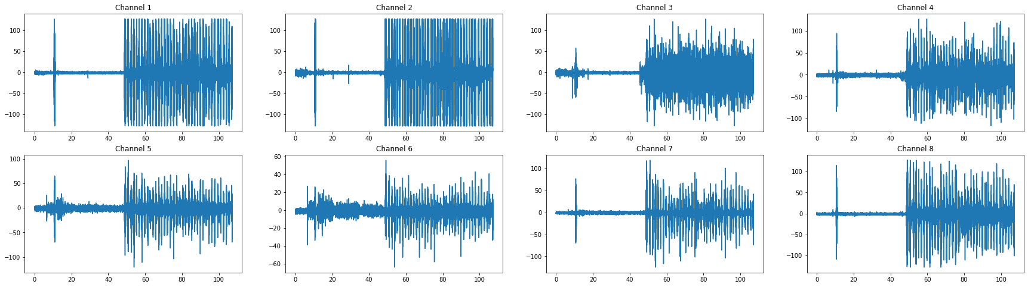
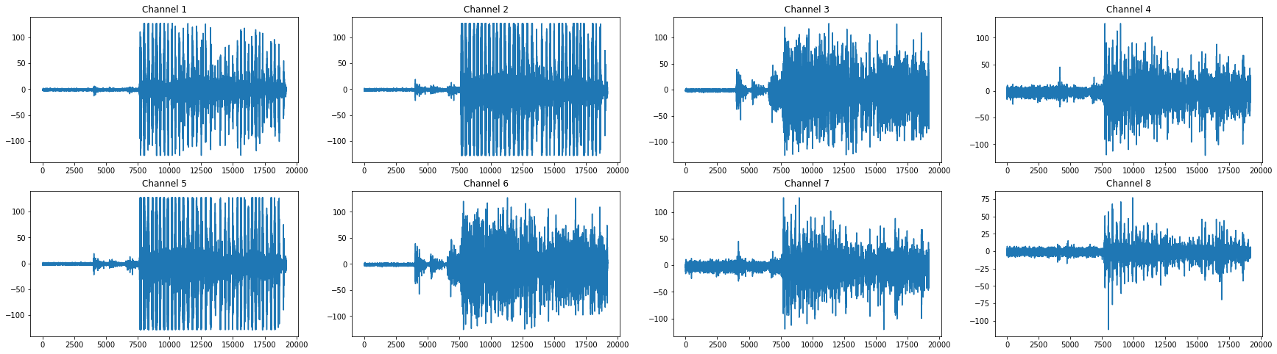
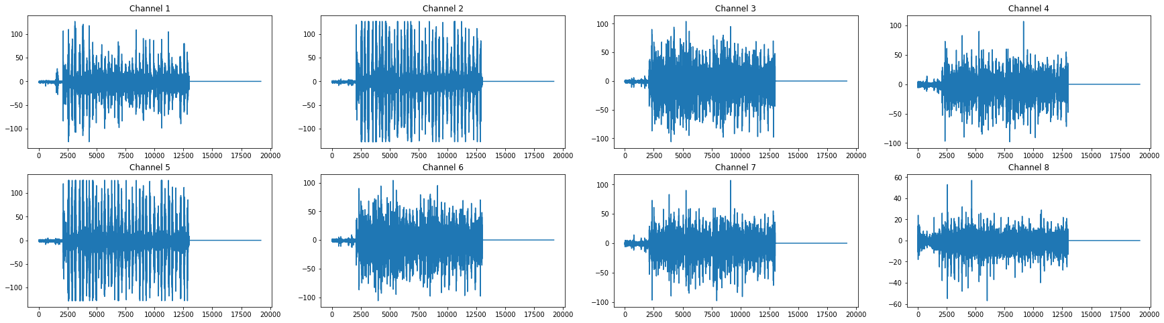
Example of RAW EMG Data
Example of EMG Data
that have been cut
Example of EMG Data
that have been pad

Slide 10
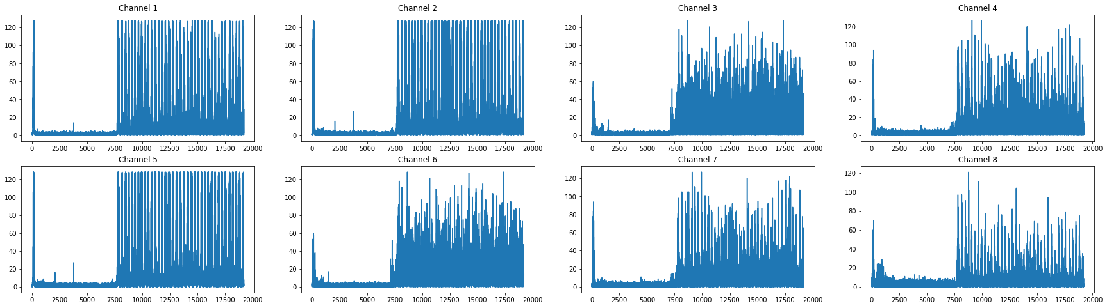
EMG Classification
For rectification, Raw EMG readings typically range from -128mV to +127mV for each timestamp and are highly oscillatory. By taking the absolute of all EMG values (all negative values become positive), the positive and negative values didn’t cancel out when calculating the mean of EMG values. Because for analysis, it is easier if the EMG signal were rectified into only positive values

Slide 11
EMG Classification
For feature extraction , Raw usage of the collected EMG data is not beneficial for machine learning due to the data's stochastic nature. The sliding windows method was used to segment time series data into a collection of short pieces (1 seconds) and with combination of Time-domain features & Frequency-domain features used as extractor.
The set of variables that were estimated from these signals are:
mean(): Mean value
std(): Standard deviation
skewness(): skewness of the frequency domain signal
kurtosis(): kurtosis of the frequency domain signal
max(): Largest value in array
min(): Smallest value in array
Sample variances()
Sample covariance()
eigenvalues covariance
upper triangular covariance
magnitude of frequency components of each signal, obtained using a Fast Fourier Transform (FFT)

Slide 12
EMG Classification
After preprocessing, the shape of our feature is (300, 96, 117, 8), which is 300 sample x 96 timestep x 117 feature x 8 channels. The data itself has 4 labels (300 x 4) closed fist (G1), spread open fingers (G2), waving inwards (G3), and waving outwards (G4)
Before the data feed into the model, we have to reshape the data from 4d into 3d by multiplying the feature and channels so the final shape will be (300, 96, 936)
After that, I normalize the feature using the Min-Max scaler so all features will be transformed into the range [-1,1]
Then, the feature is split into train and test sets (80% train and 20% test)

Slide 13
EMG Classification
LSTM model: The model is created using the Sequential class
The first layer added to the model is an LSTM layer with 128 units and an input shape = (96, 936)
The second layer is another LSTM layer with 64 units.
The third layer is a Dropout layer (20%)
Final layer is a dense layer with 4 units and an activation function of 'softmax', which is used for multi-class classification problems.
The model is then compiled using categorical_crossentropy as the loss function, and Adam optimizer with a learning rate of 0.0001, and accuracy as the metric.
The model trained using 50 epochs with 32 batch size

Slide 14
EMG Classification
CNN-LSTM model: The model is created using the Sequential class
The first layer is a TimeDistributed layer wrapped around a Conv1D layer. The Conv1D layer applies a 1D convolution operation using 64 filters, each with a kernel size of 3 and relu activation function. The input_shape variable is passed (None, 3, 936)
The second layer is similar to the first layer, but no input shape is passed this time.
The next layer is again a TimeDistributed layer wrapped around a Dropout layer with rate of 0.5.
The next layer is TimeDistributed layer wrapped around MaxPool1D layer with pool size of 2
The next layer is TimeDistributed layer wrapped around Flatten layer, this is done to prepare the data for the LSTM layer. Then it applies an LSTM layer with 100 units. Then it applies another dropout with rate of 0.5.
The final layers of the model are two dense layers. The first dense layer has 100 units and a relu activation function. The final dense layer has 4 units and a softmax activation function
The model is then compiled using categorical_crossentropy as the loss function, and Adam optimizer with a learning rate of 0.0001, and accuracy as the metric.
The model trained using 50 epochs with 32 batch size

Slide 15
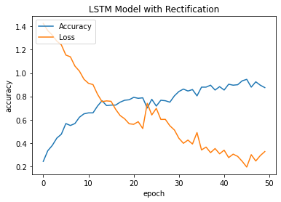
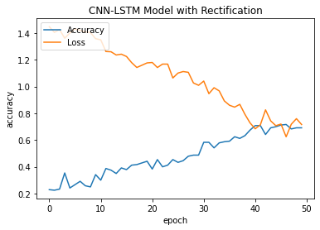
EMG Classification
LSTM model has a good result with 87.50% training accuracy and 0.3263 loss
On the other hand, the CNN-LSTM model has 69.71% training accuracy and 0.7165 loss.

Slide 16
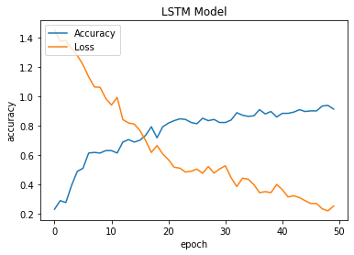
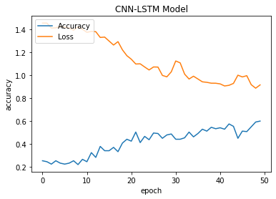
EMG Classification
Because the result of CNN-LSTM is not good enough, the model retrains using the dataset without rectification.
LSTM model has a good result with 91.25% training accuracy and 0.2515 loss
On the other hand, the CNN-LSTM model has a bad result with 60% training accuracy and 0.9153 loss. The loss value is relatively high, which suggests that the model does not fit the training data well

Slide 17
EMG Classification
As you can see in the image, the LSTM model can perform better with a dataset without rectification. Still, on the other hand, the CNN-LSTM model can perform better with the rectification dataset.

